Slide 1
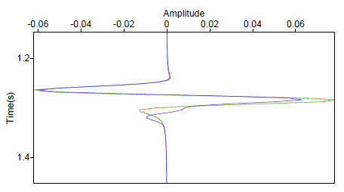
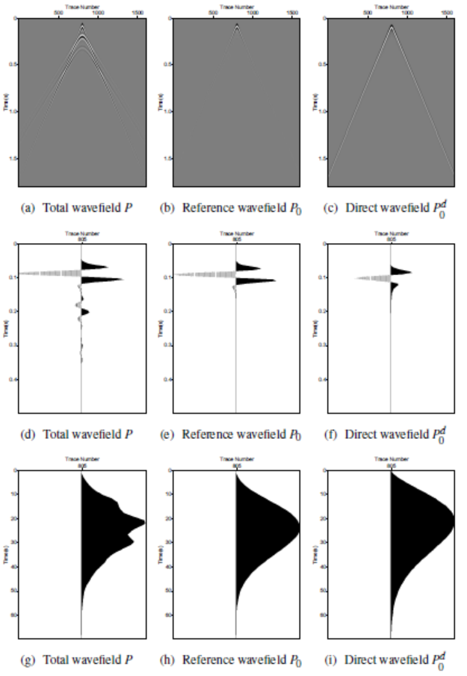
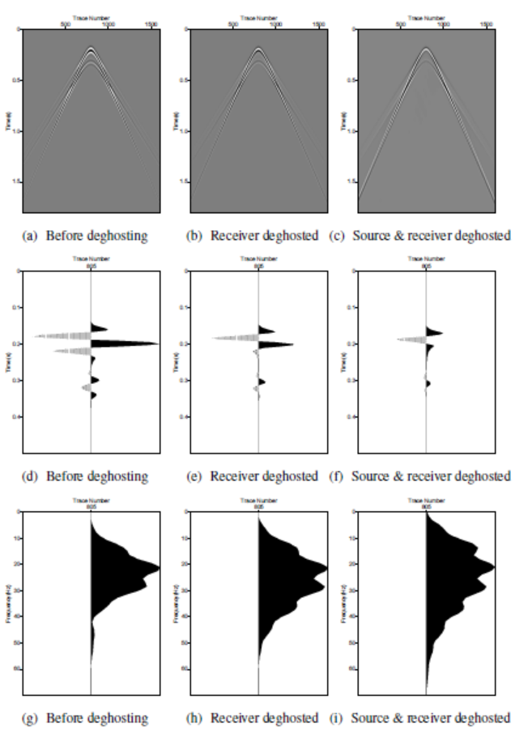
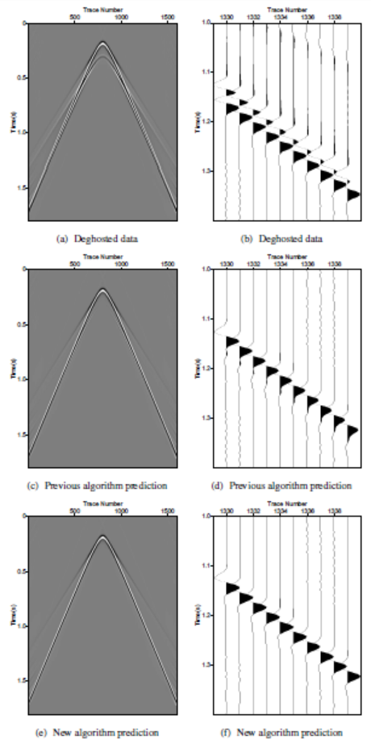
Accommodating the source (and receiver) array in the ISS free-surface multiple elimination algorithm: impact on interfering or proximal primaries and multiples
Jinlong Yang*, James D. Mayhan, Lin Tang and Arthur B. Weglein M-OSRP, The University of Houston
1. Summary
The inverse scattering series (ISS) free-surface multiple elimination (FSME) algorithm (Carvalho, 1992; Weglein et al., 1997) is modified and extended to accommodate a source (and receiver) array with a radiation pattern. That accommodation can provide added value for the fidelity of amplitude and phase prediction of free-surface multiples at all offsets, compared to previous methods that assumed a single point source (air-gun). For the source-array data, if all prerequisites are provided, the new algorithm has the theoretical capability of predicting the exact phase and amplitude of multiples, and in principle can remove them through a simple subtraction. All of its data requirements can be provided by Green’s theorem, which is consistent with the new FSME algorithm. They are both multidimensional and do not require any subsurface information. The new FSME algorithm is tested on a 1D acoustic model, and the results indicate that the new algorithm enhances the multiple prediction when the data and experiment are created by an array rather than a single air-gun.
3. Theory
The ISS FSME algorithm for an isotropic point source in a 2D case is given by (Carvalho, 1992; Weglein et al., 1997, 2003):
where $k_{g},k_{s},ω$ represent the Fourier conjugates of receiver, source, and time, respectively. The obliquity factor is given by . The FSME algorithm requires only as its input the source signature $A(ω)$ and the source and receiver deghosted data $D_{1}^{′}$. The free-surface multiples are predicted order-by-order and added together to give the deghosted and free-surface demultipled data .
For source-array data, the FSME algorithm predicts multiples only approximately. To improve the accuracy, I extended the FSME algorithm from a single point source to a source array with a radiation pattern, as follows:
where $ρ(k,q,ω)$is the projection of the source signature in the f-k domain. The algorithm requires
$ρ$ and the deghosted data. The projection of the source signature $ρ$ can be achieved from the direct wavefield $P_{0}^{ d}$, which is separated from the measured data using Green's theorem method (Weglein and Secrest, 1990). From the direct wavefield $P_{0}^{ d}$, for a 2D case, we have
where $ρ(x′,z′,ω)$is the source distribution. Using the bilinear form of Green’s function and Fourier transforming over x, we obtain the relationship between $ρ$ and $P_{0}^{ d}$
Since q is not a free variable, and we can not obtain $ρ(x,z,ω)$ in space-frequency domain by taking an inverse Fourier transform. However, the projection of the source signature, which can be derived from $P_{0}^{ d}$, is sufficient for the extended FSME algorithm.
Substituting this $ρ$ into ISS free-surface multiple removal subseries, the new FSME algorithm (Eq. 2) can be derived. This $ρ$ can also be accommodated into the ISS internal multiple attenuation algorithm. Similar analysis on the receiver array can be found in our M-OSRP annual reports.
The new FSME algorithm is fully data driven and does not require any subsurface information.
4. Numerical test
5. Conclusions
A new FSME algorithm that accommodates a source (and receiver) array is proposed and tested on data with interfering primaries and multiples. The new FMSE algorithm can provide added value compared to previous methods for the fidelity of amplitude and phase prediction of free surface multiples at all offsets. If all prerequisites are provided, the new FSME algorithm, in principle, has the ability to predict free-surface multiples precisely and can remove them through a simple subtraction. All prerequisites can be achieved by using Green‘s theorem method because it is consistent with the new FSME algorithm. They are both multidimensional and do not need any subsurface information. The numerical tests show that for source-array data, the previous isotropic source FSME algorithm can predict phase exactly but amplitude approximately. This amplitude error can seriously affect the prediction results, such as AVO analysis and inversion, when a multiple intersects a primary. The new FSME algorithm can accommodate array data and eliminate free-surface multiples without damaging or touching primaries. In summary, I have extended the multiple removal algorithm by incorporating the source array to match the physics of the experiment. This is part of a strategy to build more effectiveness and provide new capability in removing multiples under complex circumstances.
The new FSME algorithm is tested on the source-array data with overlapping or interfering primaries and multiples. The tests are organized as follows: First, the source-array data is generated. Second, we preprocess the generated data using Green’s theorem method. Third, we input the preprocessed data into the previous FSME (1) and the new FSME (2) algorithms to predict and remove the free-surface multiples and compare their results.
The tests are based on a 1D model (Fig. 1). The model has one shallow reflector at 90m, hence, the primary is interfering and overlapping with the free-surface multiples. Using Cagniard-de Hoop method, the synthetic data are generated by a source array that contains nine air-guns in one line with 24m range (Fig. 2).
Figure 1： Acoustic model
Figure 6： Comparison at offset = 1800m. Red: the generated primary; After multiple removal using the previous FSME (blue) and the new FSME (green dash) algorithms.
Figure 2： Source array
2. Introduction
In seismic exploration, multiple removal is a long-standing problem. Various methods have been developed to either attenuate or remove multiples. The ISS FSME algorithm is fully data driven and does not need any subsurface information. If all the prerequisites are provided, it has the ability to accurately predict the free-surface multiples and remove them without needing adaptive subtraction based on certain criteria (energy minimization, for example), since the energy minimization criterion can be invalid or fail if primaries and multiples are overlapping or proximal.
For source-array data, the ISS FSME algorithm is not sufficient because it is designed for a single point source. In marine acquisition, a source array is commonly used to increase the power of the source, broaden the bandwidth, and cancel the random noise. The source array exhibits directivity and has effects on AVO analysis and multiple removal. Therefore, it is essential that we characterize the source (and receiver) array's effect on the FSME algorithm.
The new extended FSME algorithm has certain data requirements: (1) removal of the reference wavefield, (2) an estimation of source wavelet and radiation pattern, and (3) source and receiver deghosting. All can be obtained using Green's theorem methods.
6. Acknowledgments
We are grateful to the M-OSRP sponsors for their encouragement and support to this work.
Figure 3： Wave separation and deghosting
Figure 4： Deghosting the scattered wavefield
Figure 5： FS multiple removal
Figure 3 shows that the total wavefield 3(a) is separated by Green’s theorem method into two parts: the reference wavefield $P_{0}$ 3(b) and the scattered wavefield $P_{s}$4(a); the direct wavefield $P_{0}^{ d}$ 3(c) is obtained by source deghosting the reference wavefield $P_{0}$.
The scattered wavefield 4(a) receiver deghosted 4(b) and then source deghosted 4(c), as shown in Figure 4. Both deghosting procedures recover more low frequency information and do not damage or touch the primary.
Figure 5 illustrates that the free-surface multiples are removed by the previous and the new FSME algorithms with the former showing artifacts, which are removed in the latter.
7. Further information
If you want more information about this work, please look at the full Abstract http://dx.doi.org/10.1190/segam2013-0817.1 and our website http://www.mosrp.uh.edu/.
E-mail: jyang15@uh.edu.
8. References
Carvalho, P. M., 1992, Free-surface multiple reflection elimination method based on nonlinear inversion of seismic data: PhD thesis, Universidade Federal da Bahia.
Weglein, A. B., F. V. Araújo, P.M. Carvalho, R. H. Stolt, K. H. Matson, R. T. Coates, D. Corrigan, D. J. Foster, S. A. Shaw, and H. Zhang, 2003, Inverse scattering series and seismic exploration: Inverse Problems, R27–R83.
Weglein, A. B., F. A. Gasparotto, P. M. Carvalho, and R. H. Stolt, 1997, An inverse-scattering series method for attenuating multiples in seismic reflection data: Geophysics, 62, 1975–1989.
Weglein, A. B., and B. G. Secrest, 1990, Wavelet estimation for a multidimensional acoustic earth model: Geophysics, 55, 902–913.

